Slide 1
LECTURE 09: ADDING DETAIL
November 10, 2016
SDS136:
Communicating with Data

Slide 2

Bringing it all together

Slide 3
Outline
Multiple datasets
Customizing the look of a visualization
Adding custom icon sets
Working with filters
Conditional backgrounds
Adding images
Details on demand (external resources)
If you want to follow along in Tableau:
www.science.smith.edu/~jcrouser/SDS136/labs/superhero-walkthrough

Slide 4
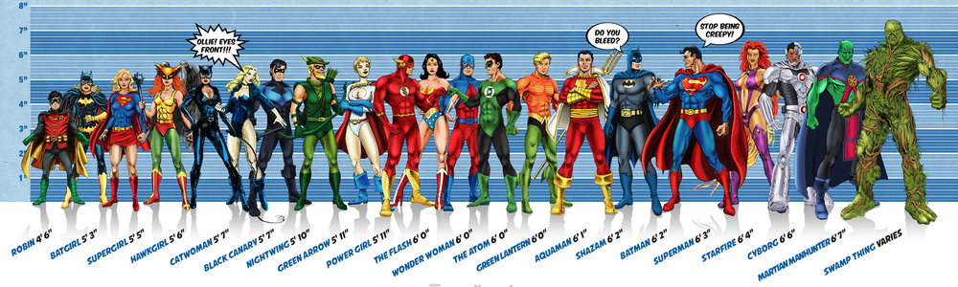
Running example: superheroes
Image credit: Ming Malaykham

Slide 5
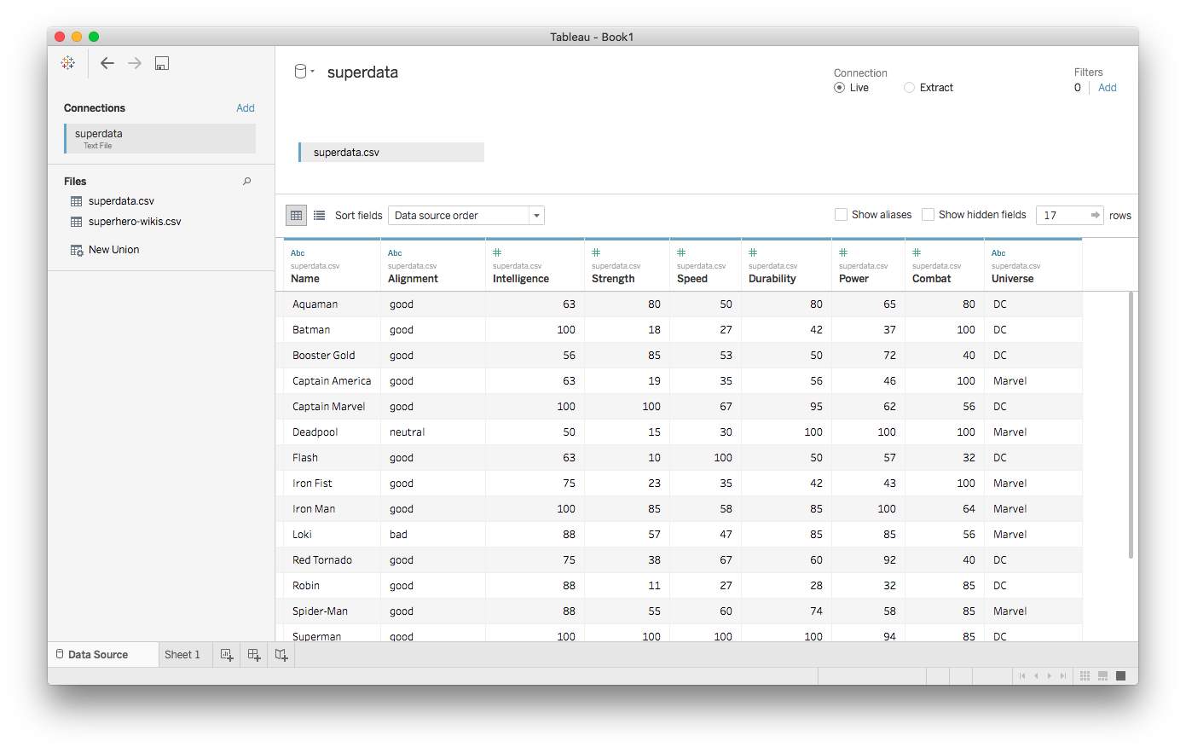
First dataset: superdata.csv

Slide 6
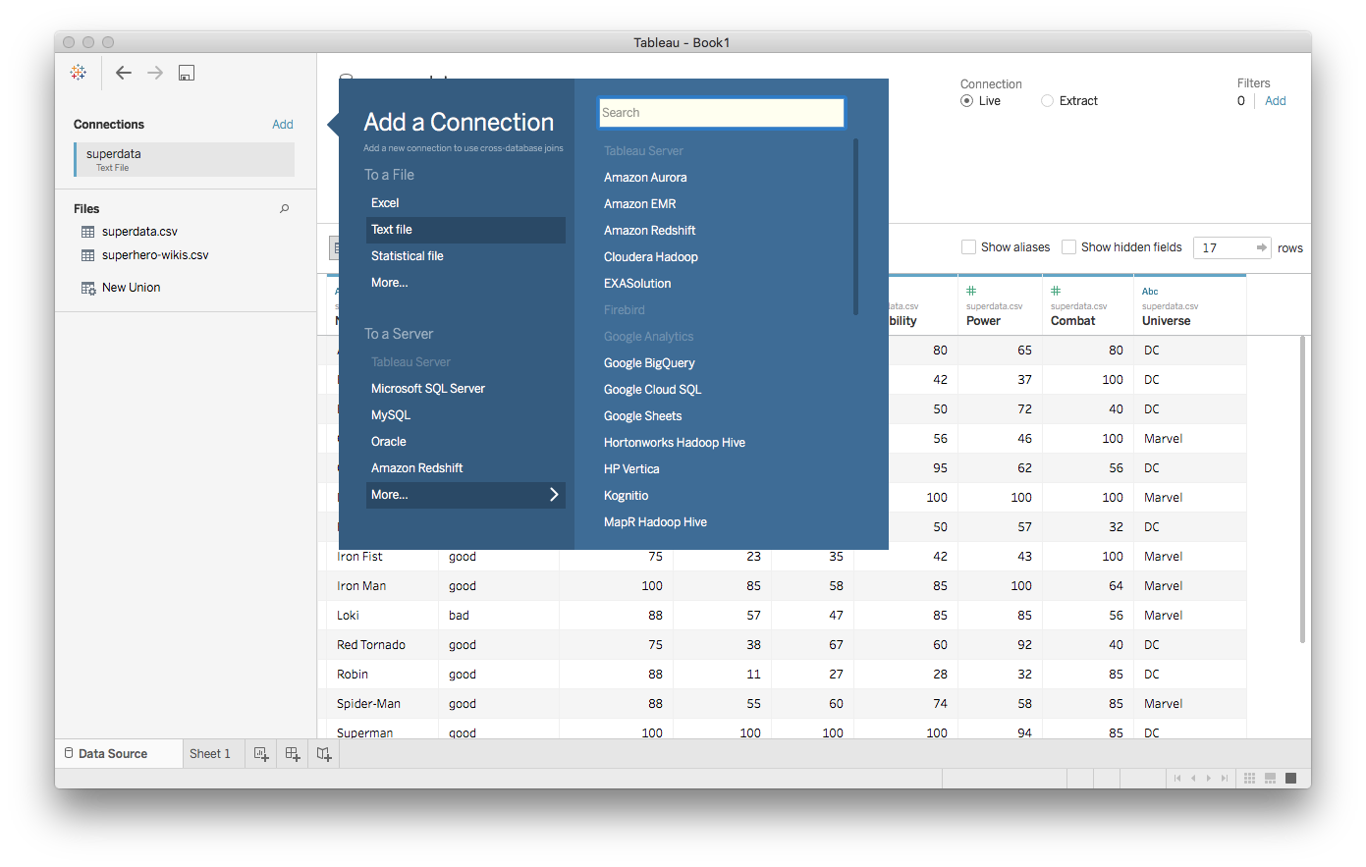
Adding more datasets

Slide 7
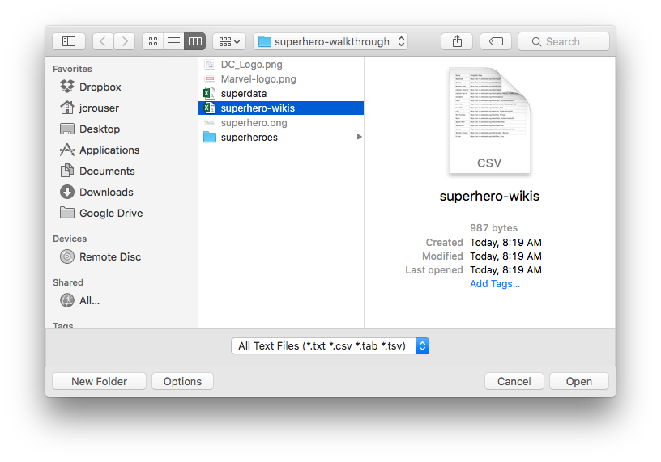
Adding more datasets

Slide 8
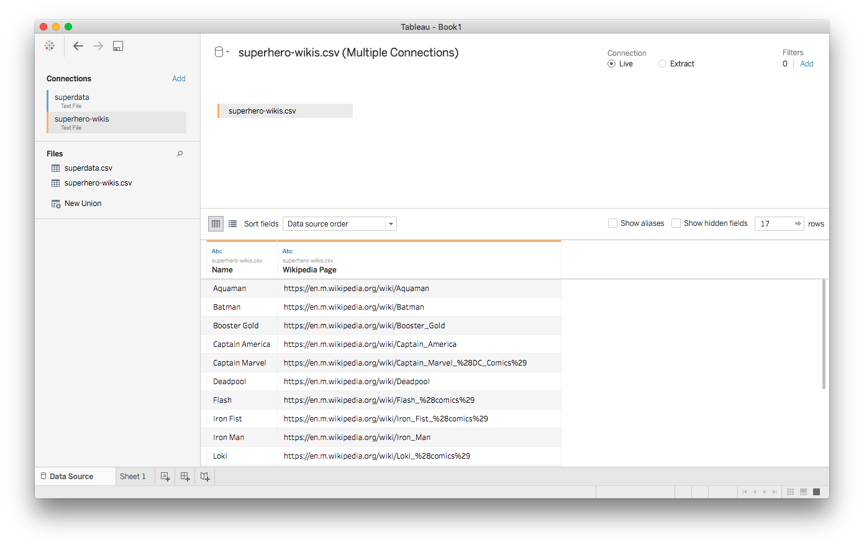
Second dataset: superhero-wikis.csv

Slide 9
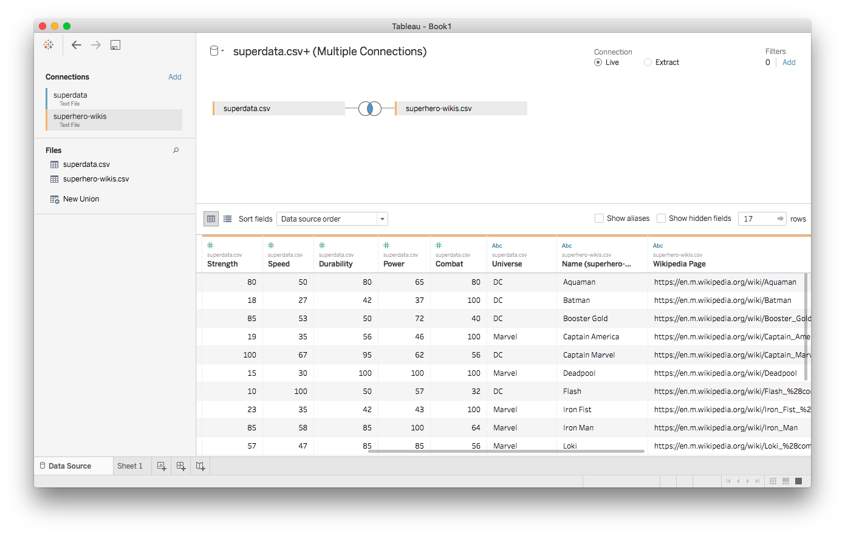
Joining the two

Slide 10
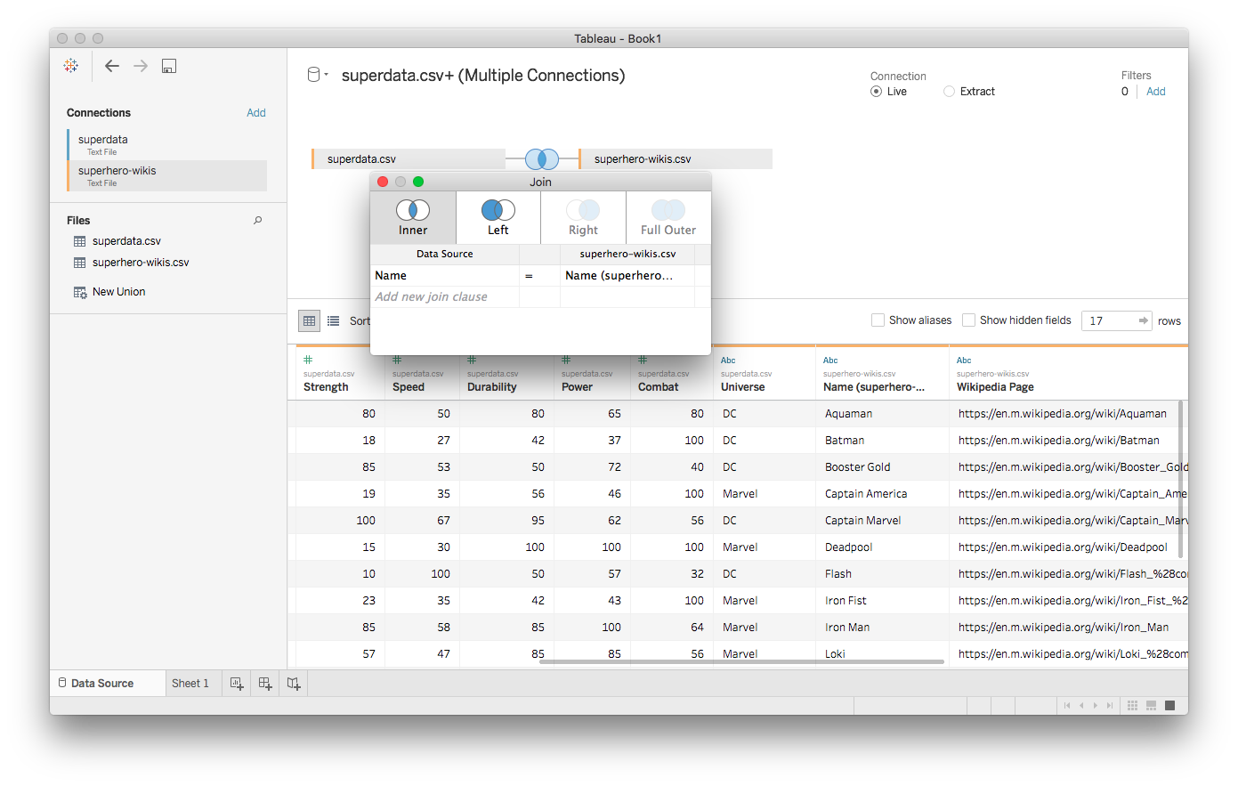
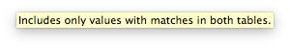
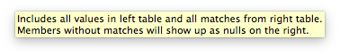
Joining the two
z

Slide 11
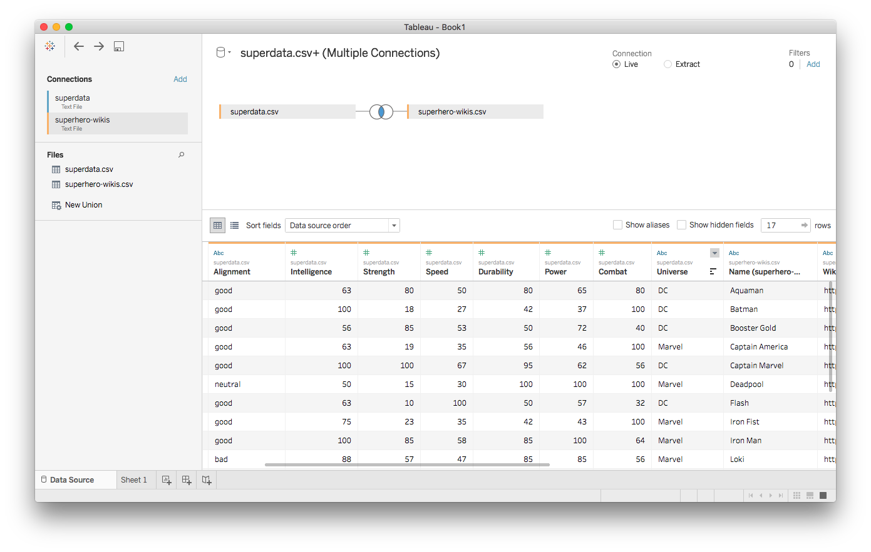
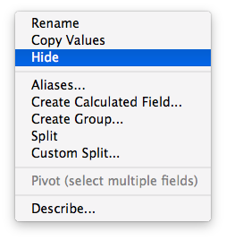
Hiding unnecessary data

Slide 12
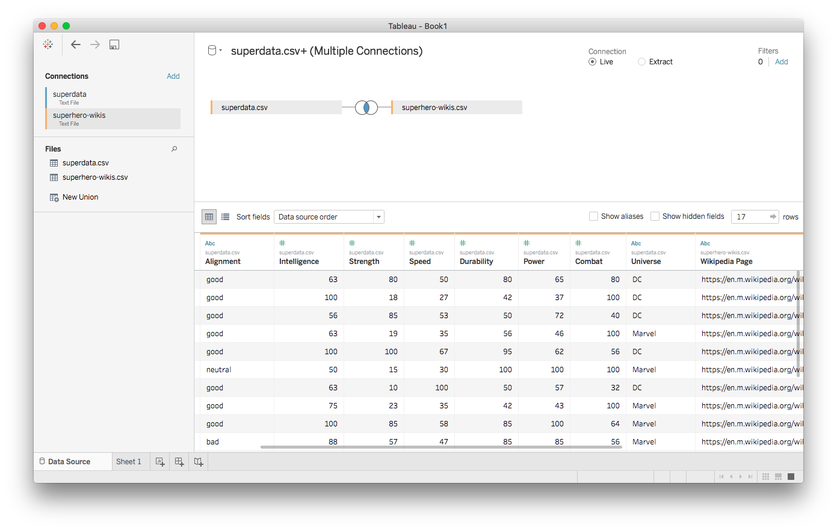
Ready to go!

Slide 13
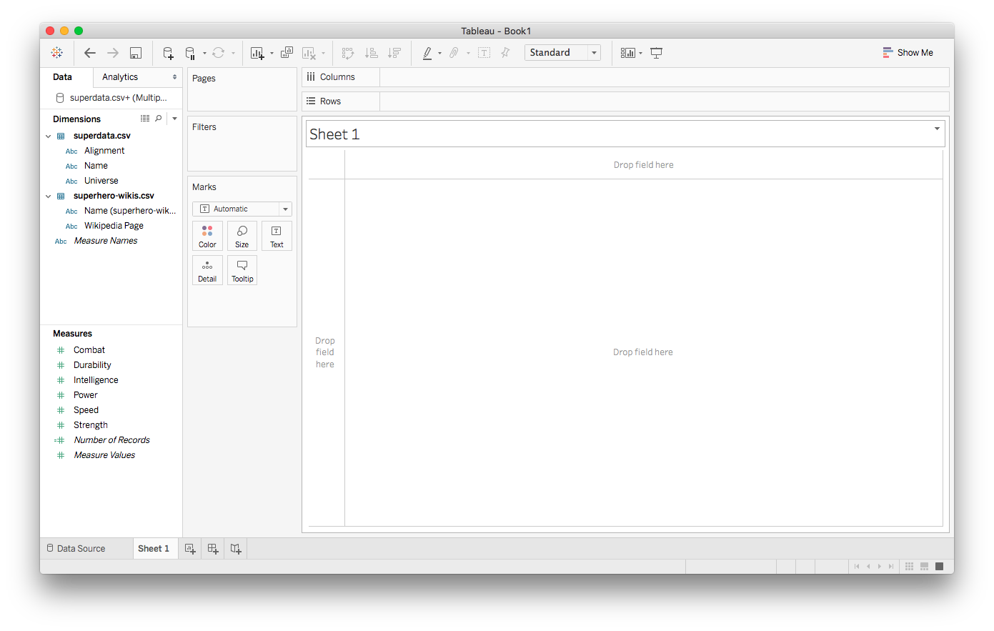
Over to Sheet1

Slide 14
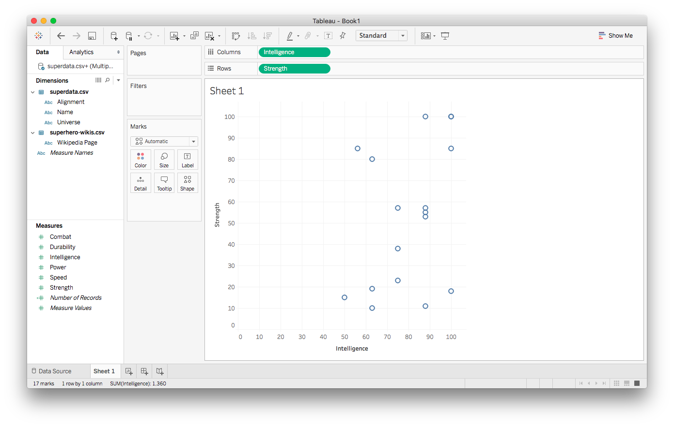
Simple scatterplot

Slide 15
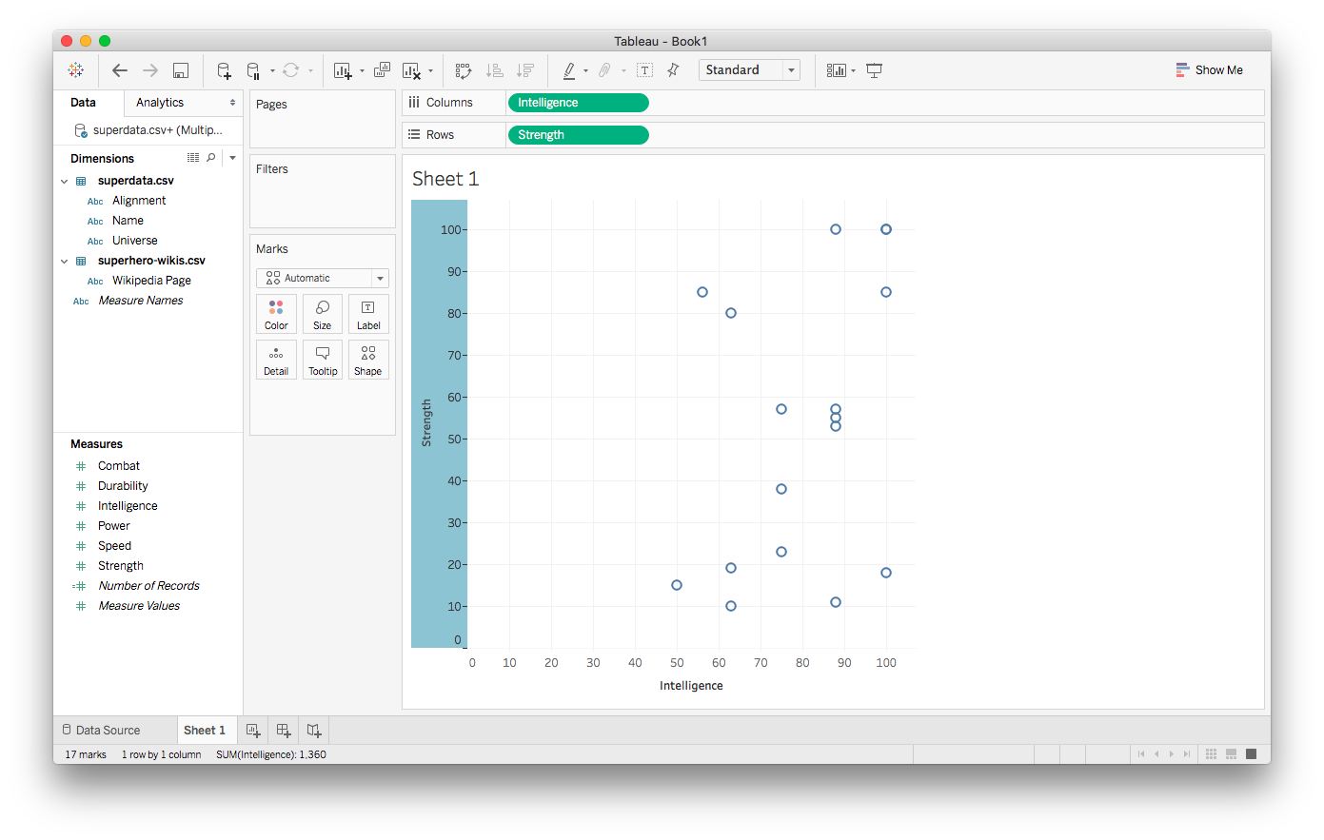
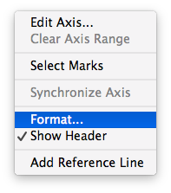
Editing axes

Slide 16
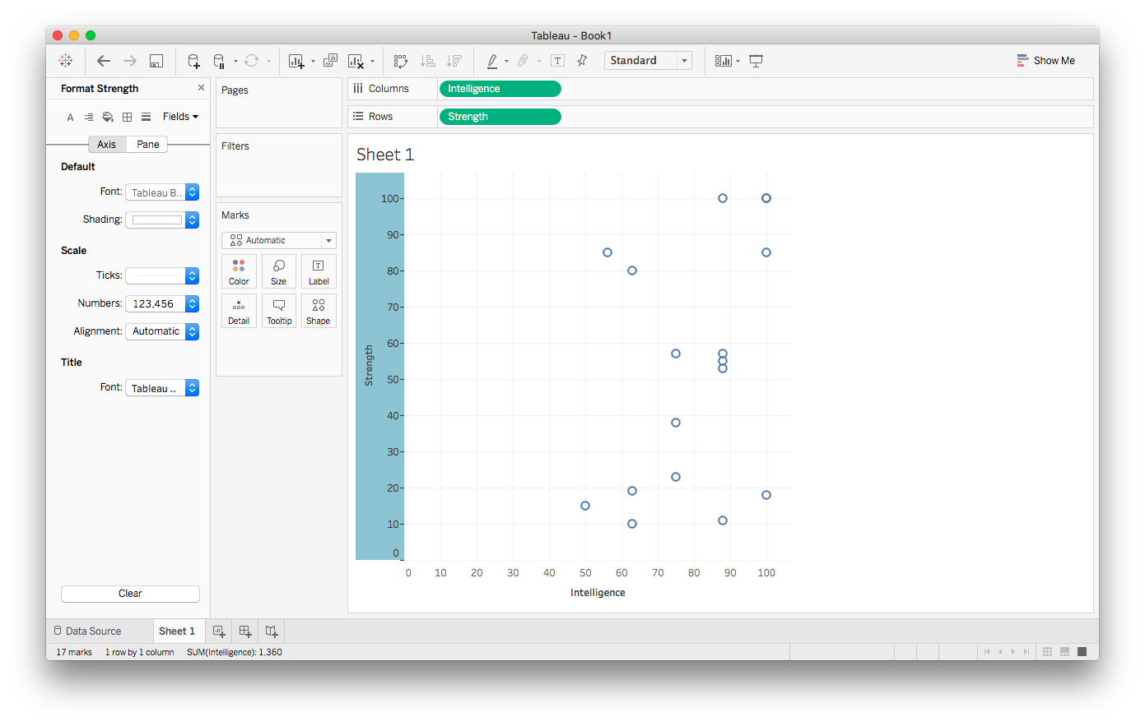
Editing axes

Slide 17
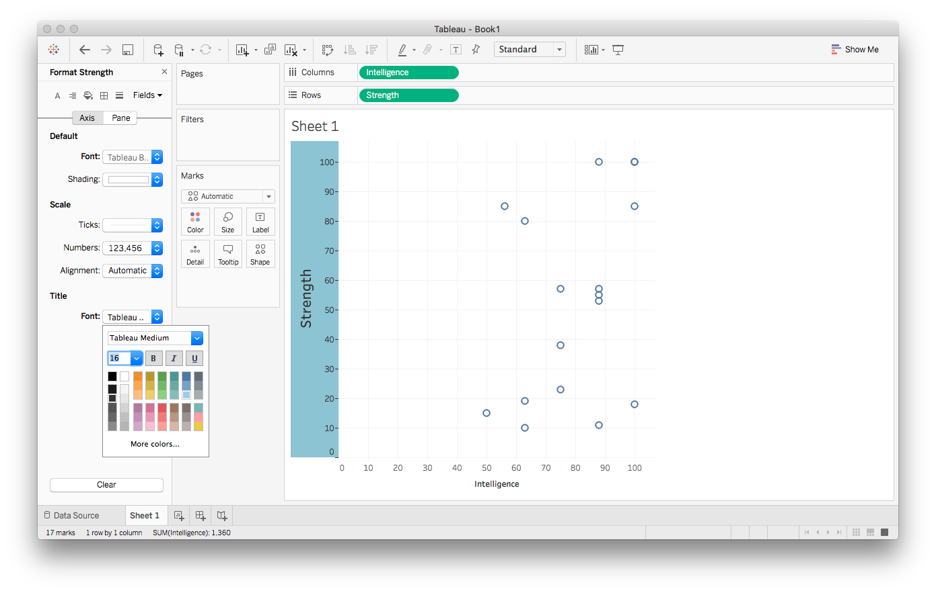
Editing axes

Slide 18
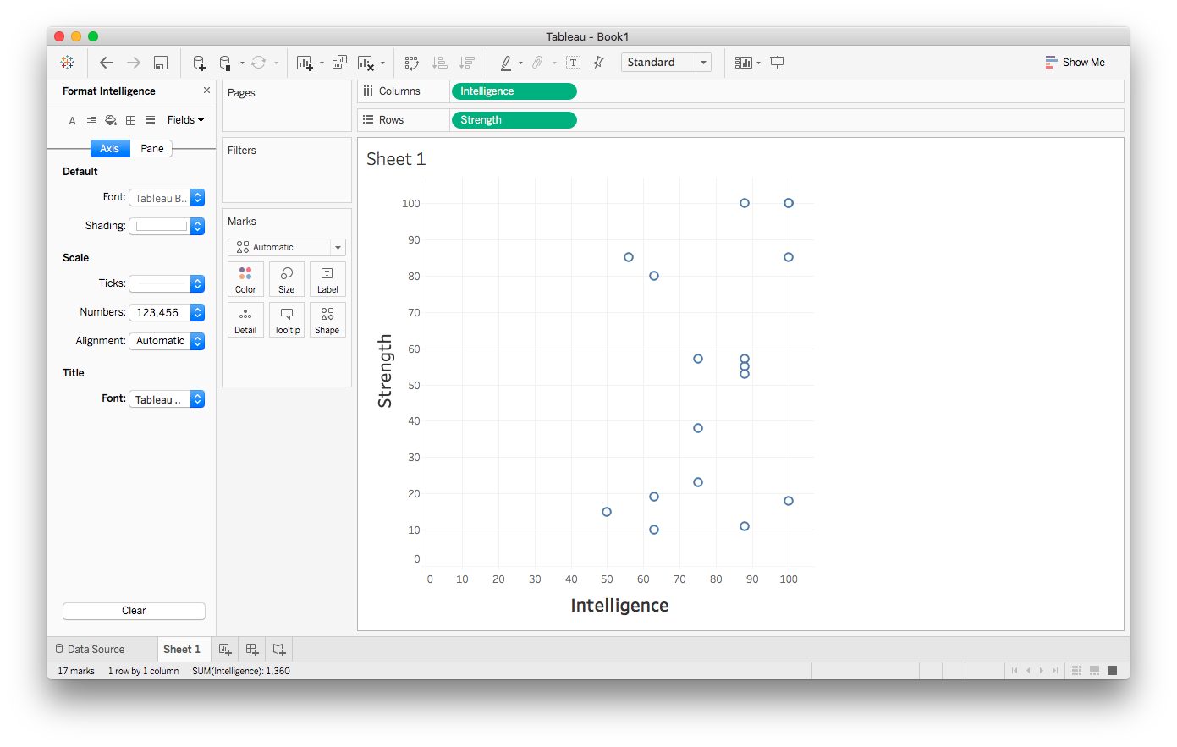
Editing axes

Slide 19
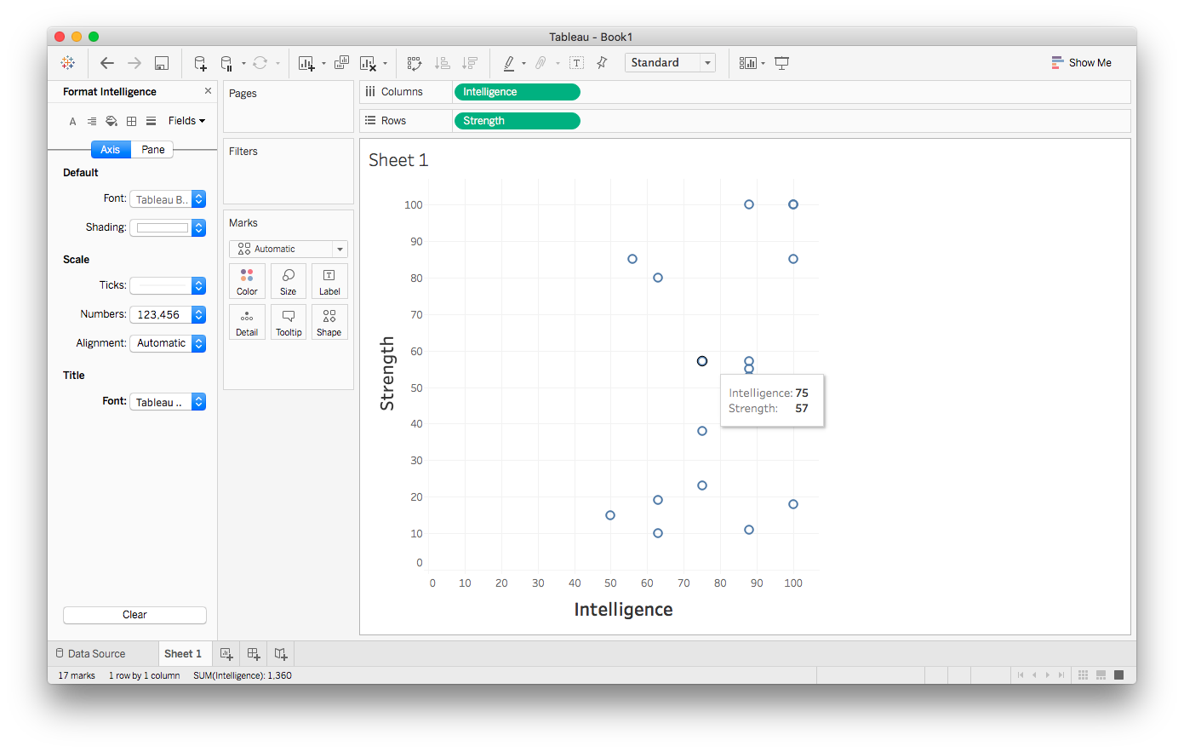
More interesting tooltips

Slide 20
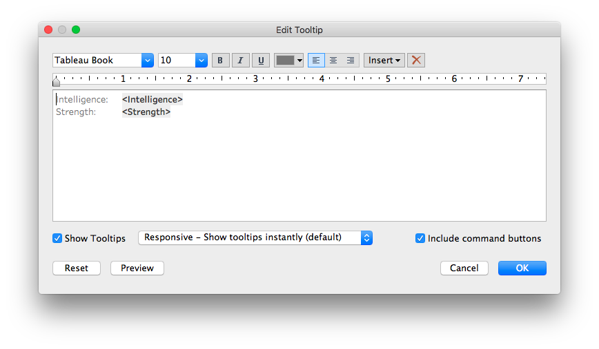
More interesting tooltips

Slide 21
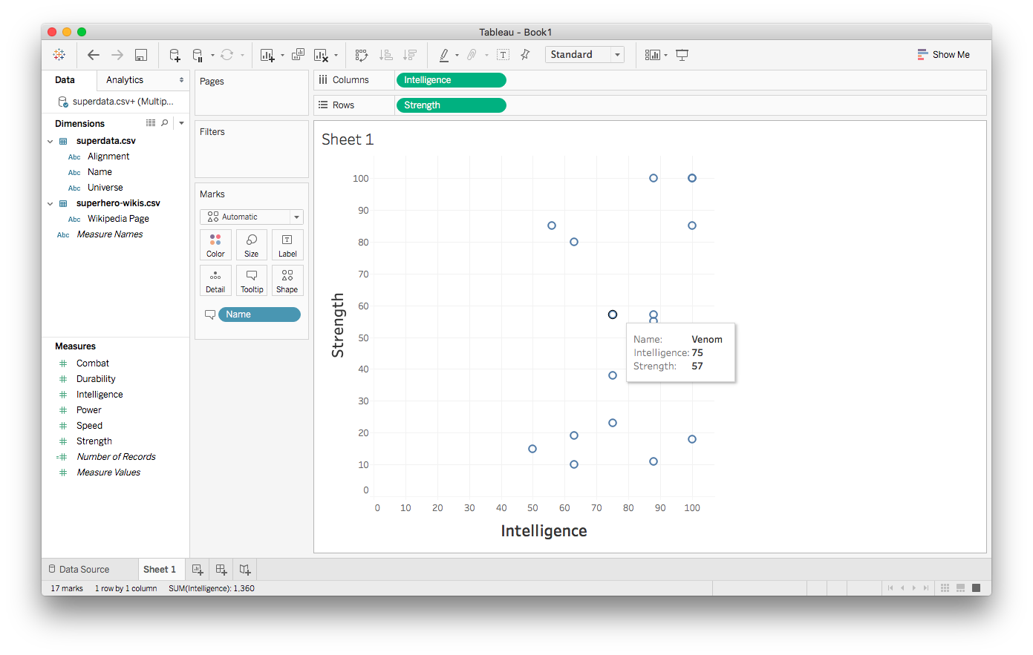
More interesting tooltips

Slide 22
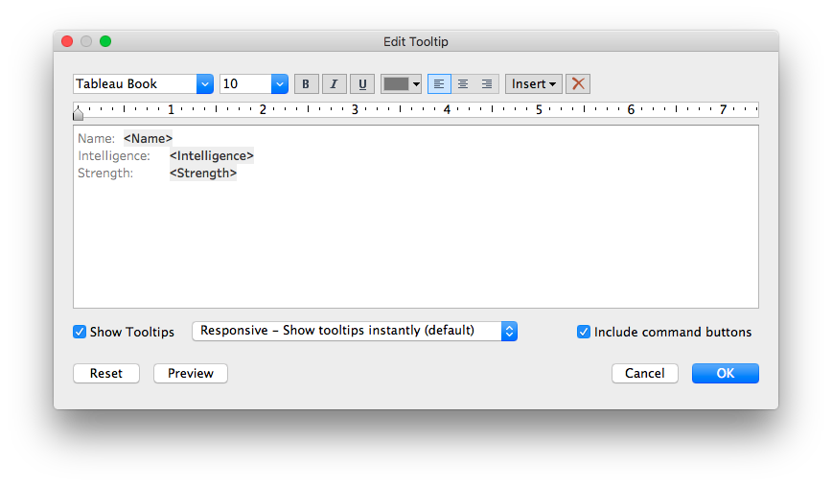
More interesting tooltips

Slide 23
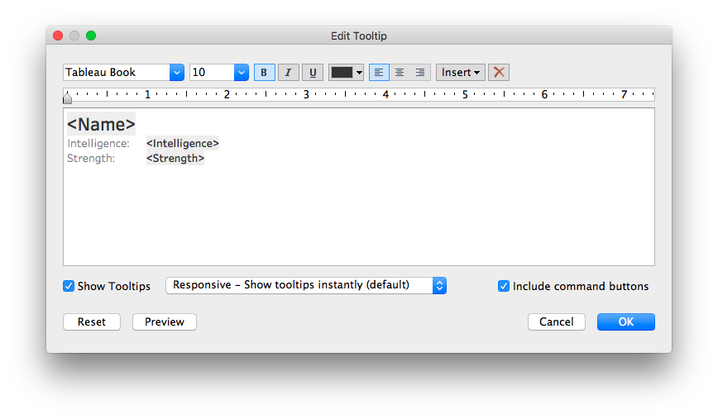
More interesting tooltips

Slide 24
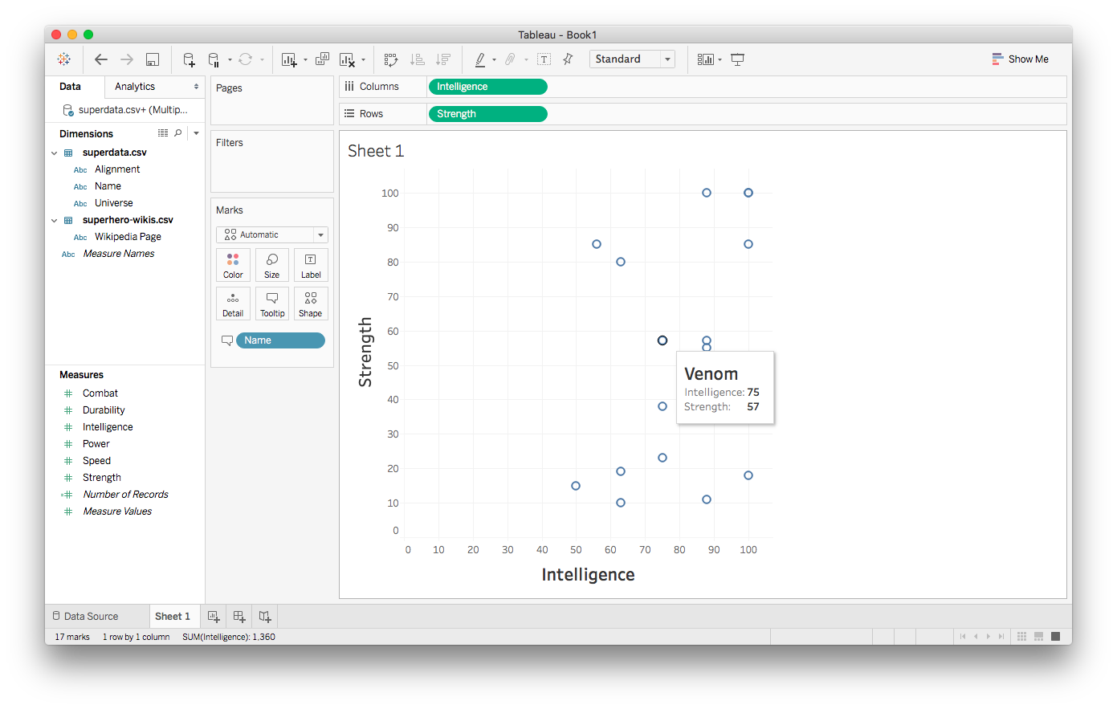
More interesting tooltips

Slide 25
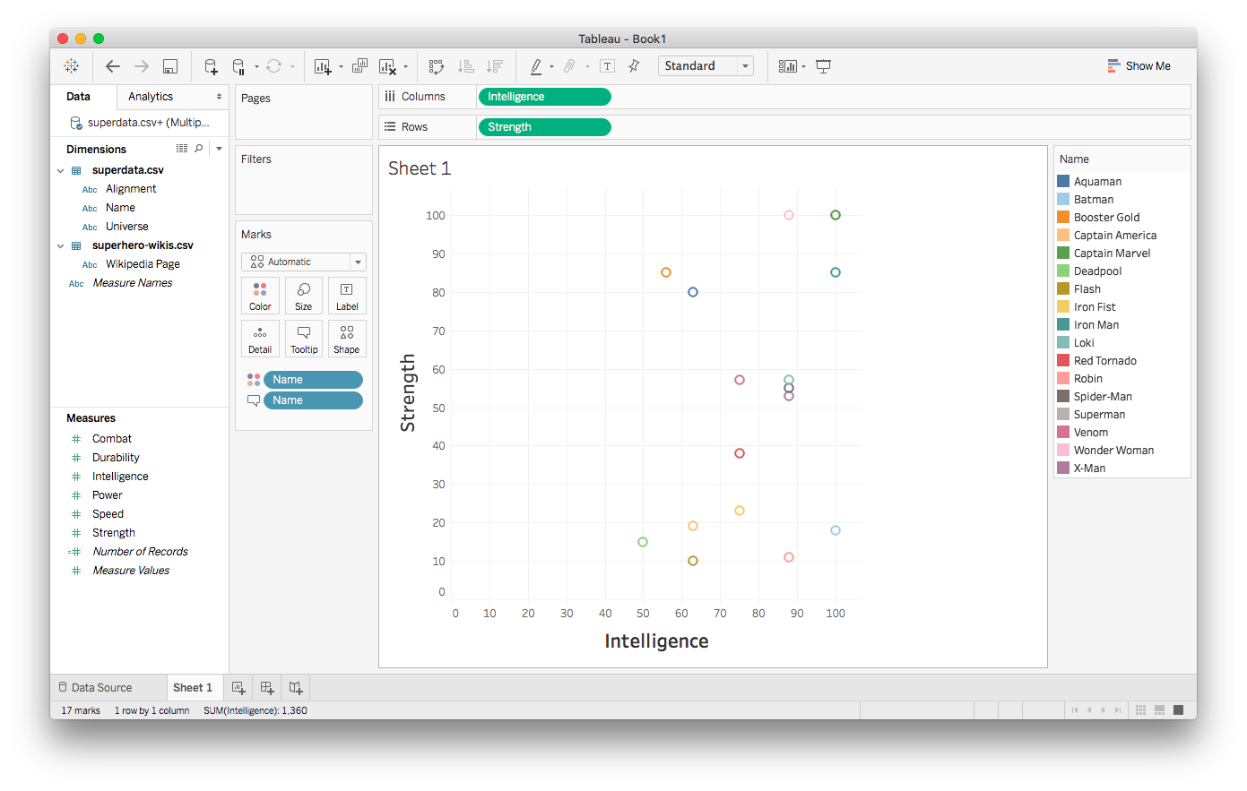
Adding color

Slide 26
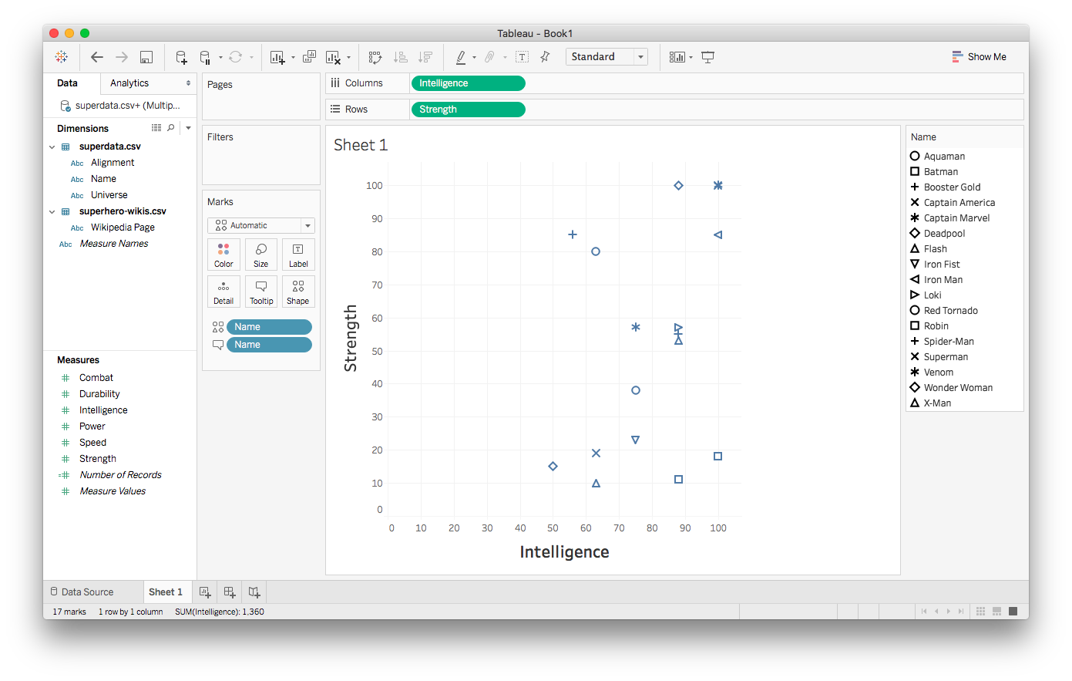
Trying shapes instead

Slide 27
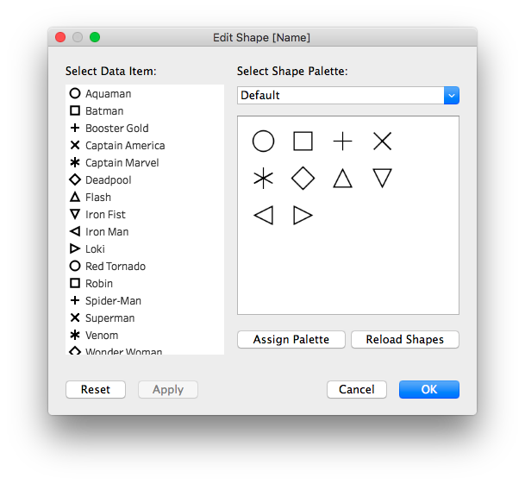
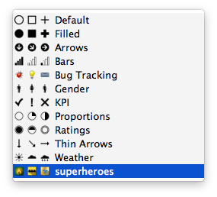
Exploring shapes

Slide 28
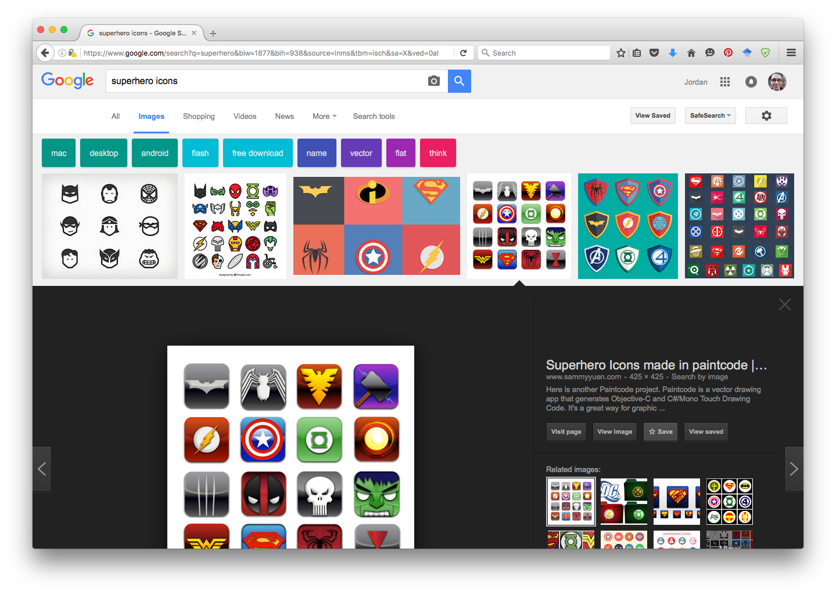
Adding custom shapes

Slide 29
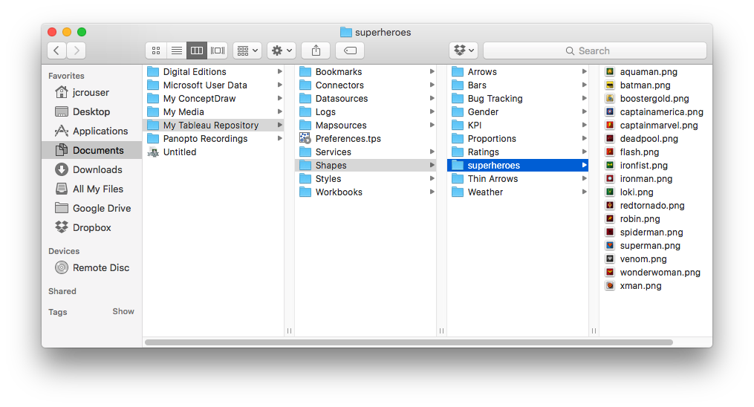
Adding custom shapes

Slide 30

Adding custom shapes

Slide 31
Adding custom shapes

Slide 32
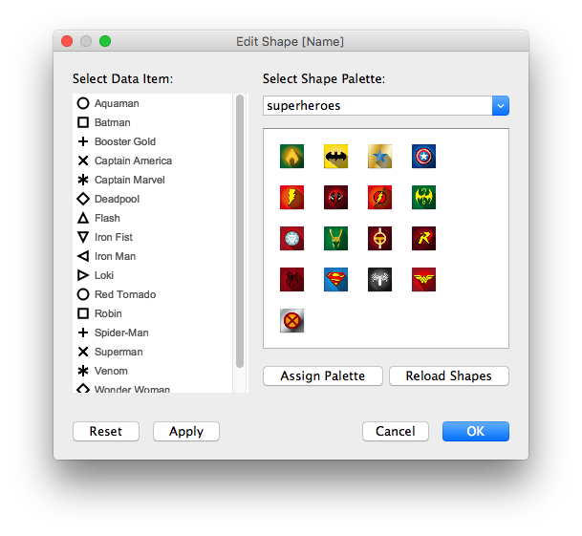
Adding custom shapes

Slide 33
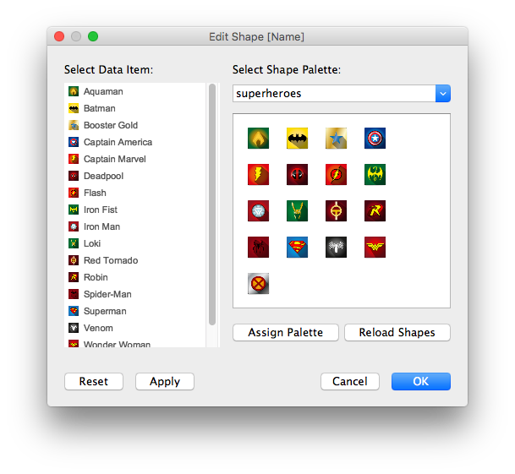
Adding custom shapes

Slide 34
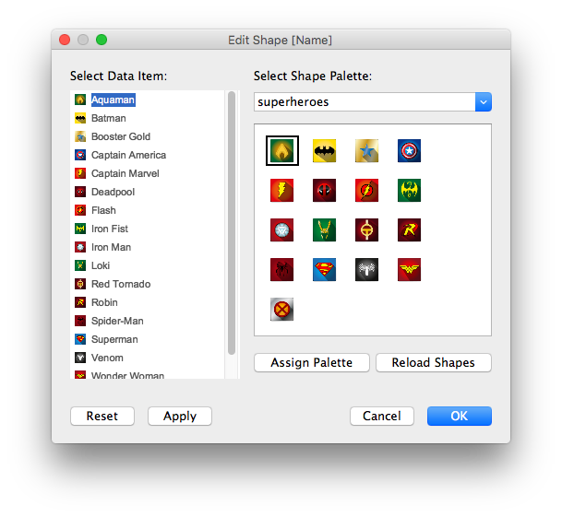
Adding custom shapes

Slide 35
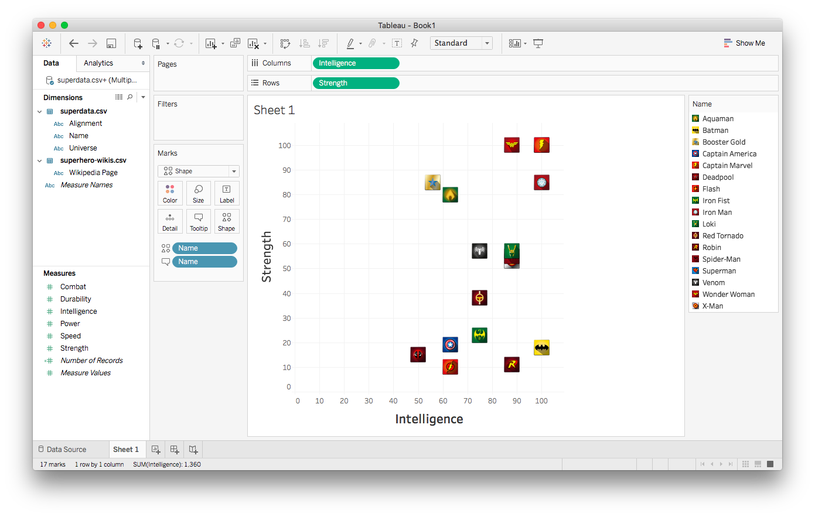
Scatterplot with custom shapes

Slide 36
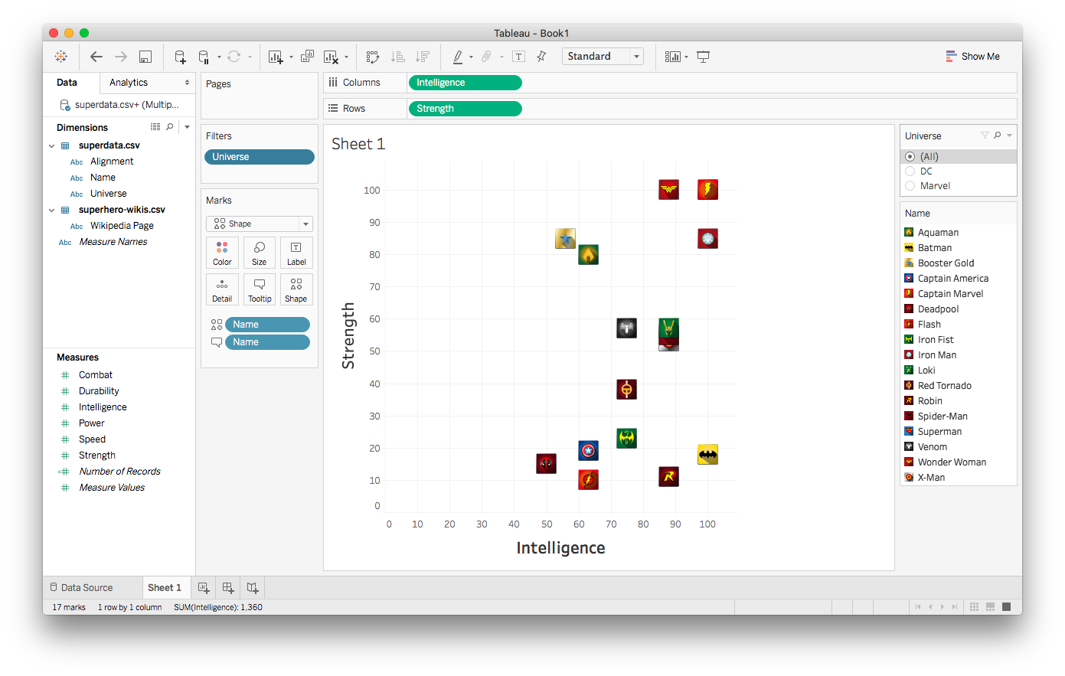
Working with filters

Slide 37
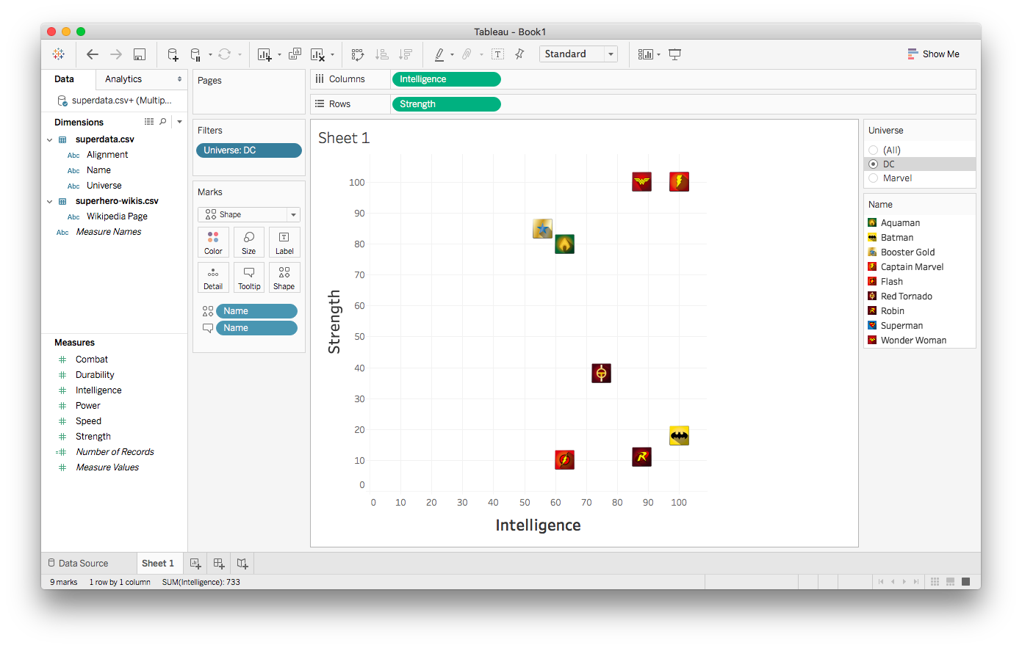
Working with filters

Slide 38
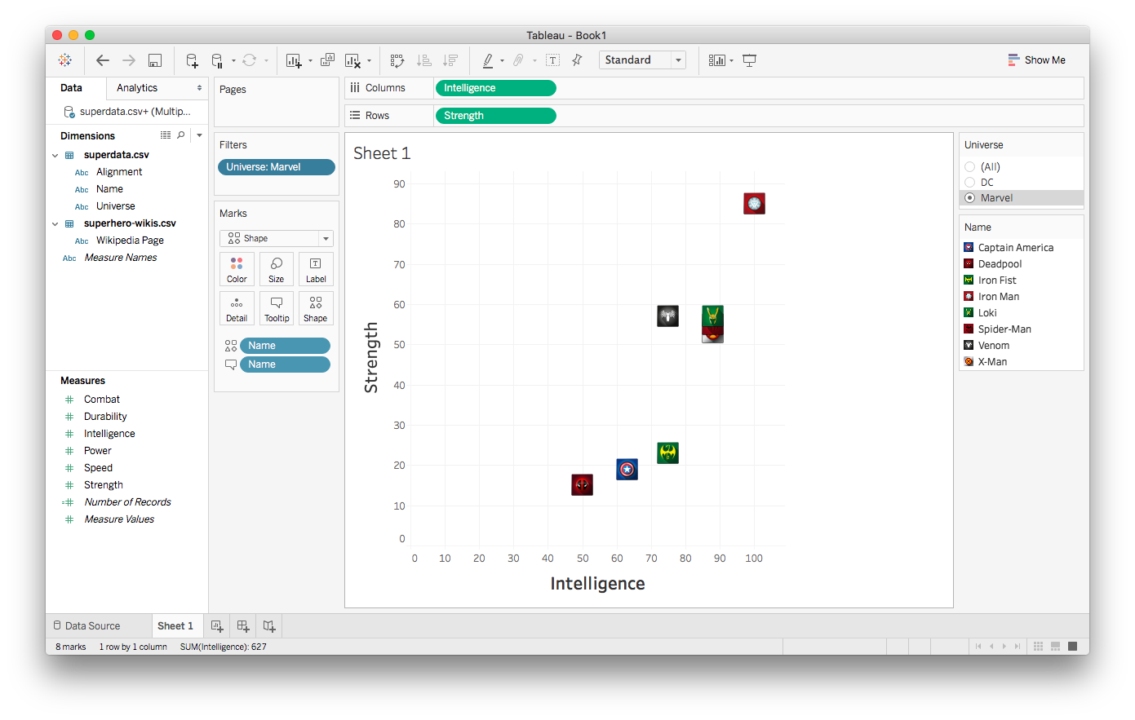
Working with filters

Slide 39
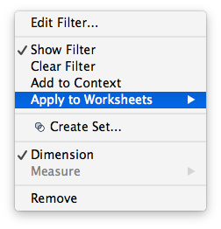
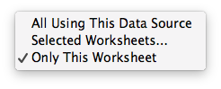
Changing a filter’s scope

Slide 40
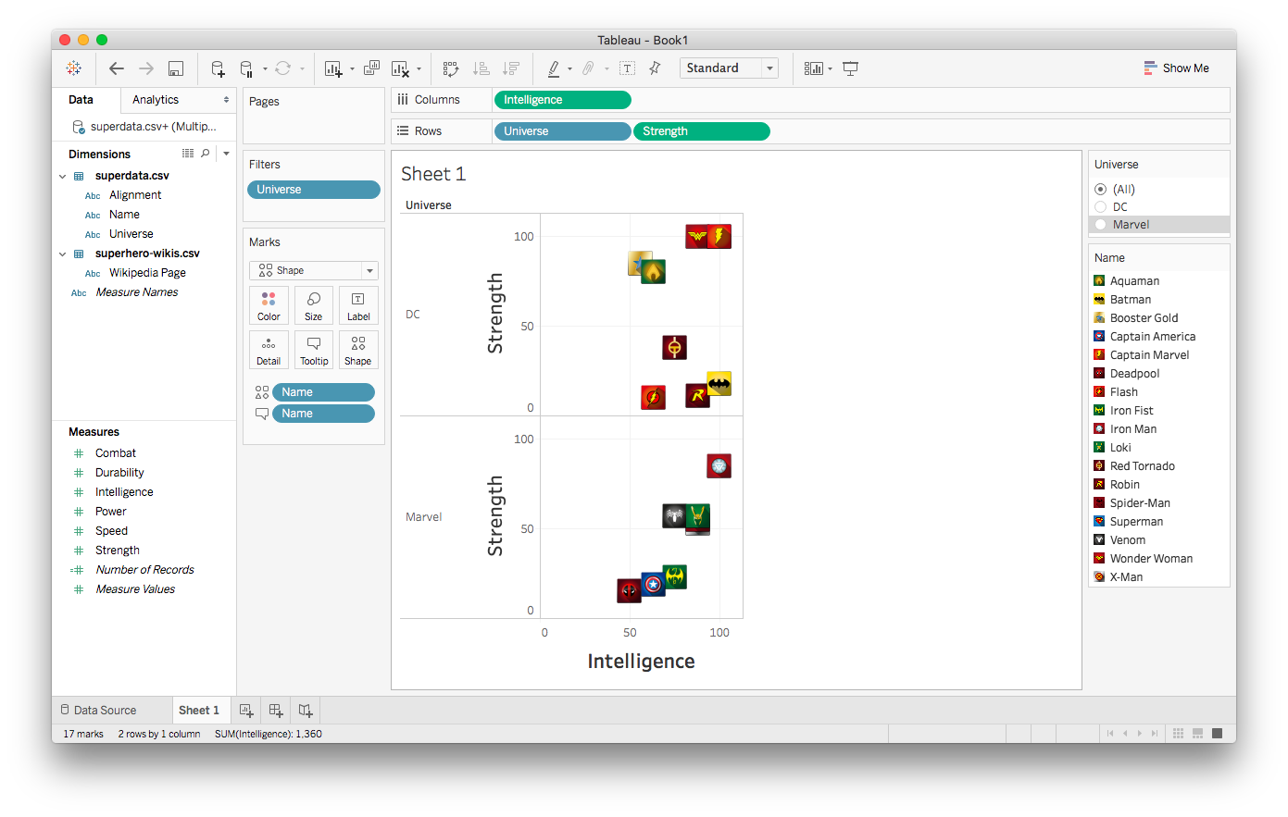
Implicit filtering (side-by-side comparison)

Slide 41


Adding background images

Slide 42
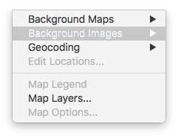
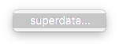
Adding background images

Slide 43
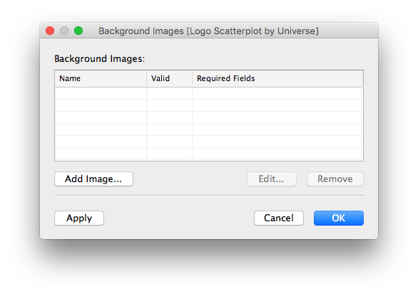
Adding background images

Slide 44
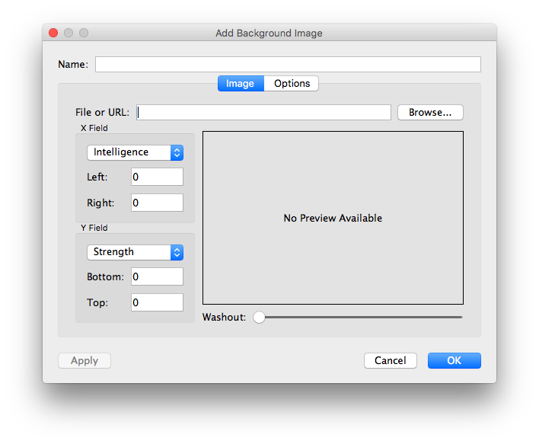
Adding background images

Slide 45
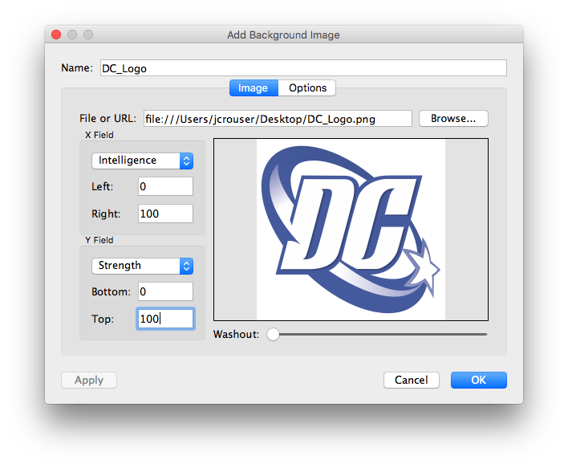
Adding background images

Slide 46
Adding background images

Slide 47
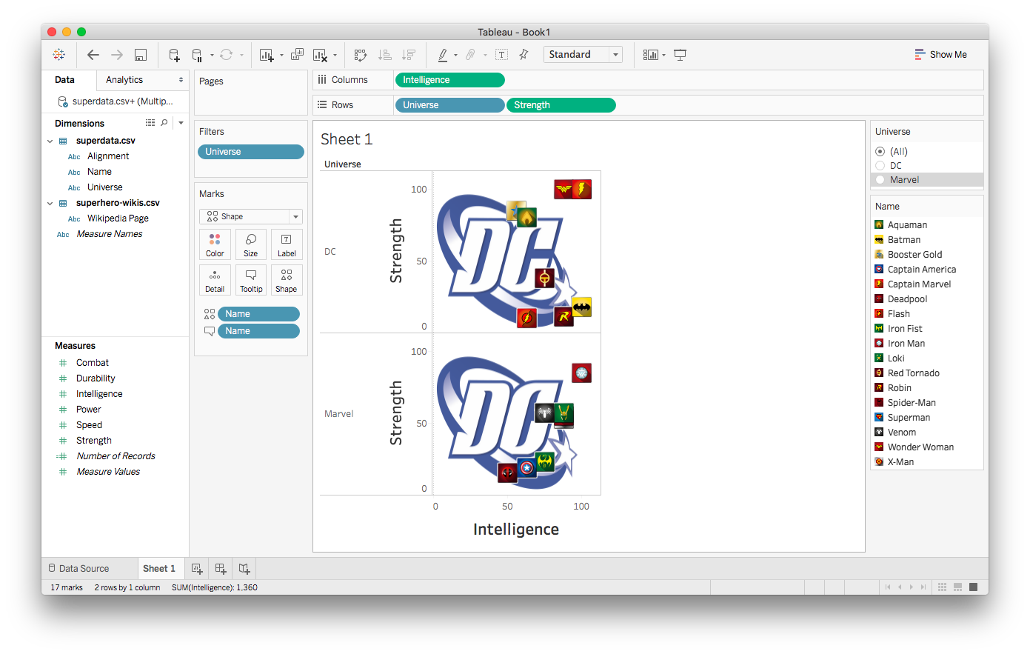
Adding background images

Slide 48
Adding background images

Slide 49
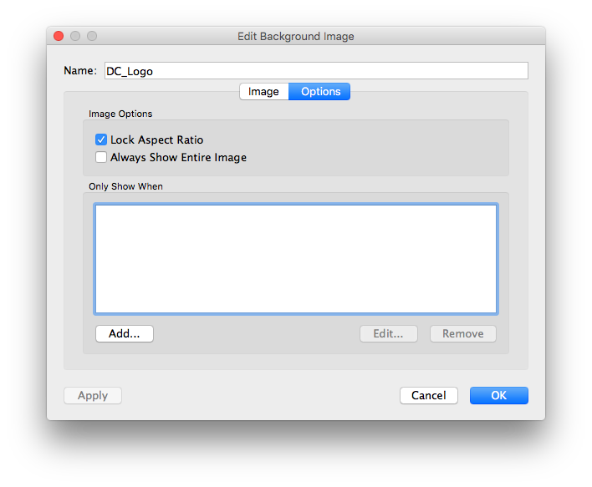
Adding background images

Slide 50
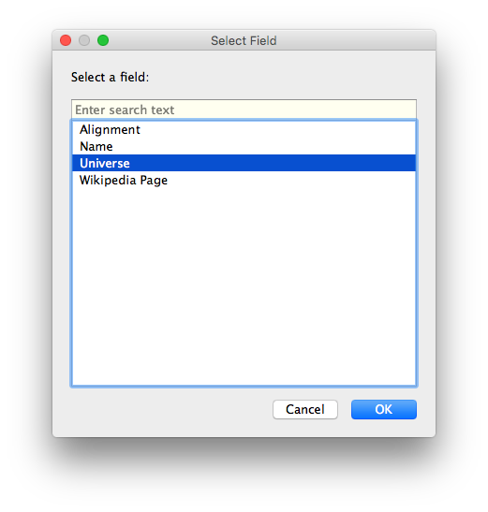
Adding background images

Slide 51
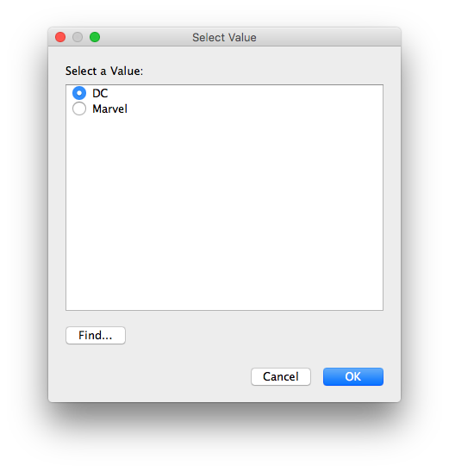
Adding background images

Slide 52

Adding background images

Slide 53

Adding background images

Slide 54

Adding background images

Slide 55

Adding background images

Slide 56

Adding background images

Slide 57

Adding background images

Slide 58

Customizing a dashboard

Slide 59

Customizing a dashboard

Slide 60

Customizing a dashboard

Slide 61

Flashback: dataset

Slide 62

Load external data on click

Slide 63

Load external data on click

Slide 64

Load external data on click

Slide 65

Load external data on click

Slide 66


Load external data on click

Slide 67


Load external data on click

Slide 68

Load external data on click

Slide 69

Load external data on click

Slide 70

Load external data on click

Slide 71
Load external data on click

Slide 72

Load external data on click

Slide 73

Load external data on click

Slide 74
Recap
Multiple datasets
Customizing the look of a visualization
Adding custom icon sets
Working with filters
Conditional backgrounds
Adding images
Details on demand (external resources)

Slide 75
Coming up
•Next final project milestone:
-Piazza post: persona and competitive review
-Due Tuesday by 11:59pm

